Slide 1
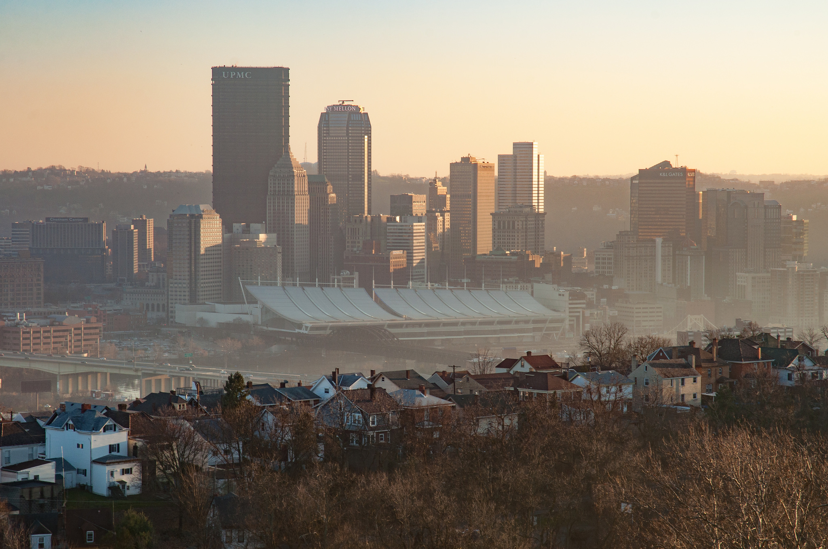
Air Quality in Allegheny County
Which area/neighborhood has
the worst air pollution?

Slide 2
Sulfur Dioxide
Sources of SO₂
Burning fossil fuels – coal, oil, diesel.
Locations such as power plants, metals processing and smelting facilities, and automobiles.
Harmful Effects of SO₂
Sulfur Oxides react with other compounds in the air to form particulates
Resulting particulates create haze
High concentrations can damage foliage and prevent growth
Short-term exposure harmful to respiratory system

Slide 3
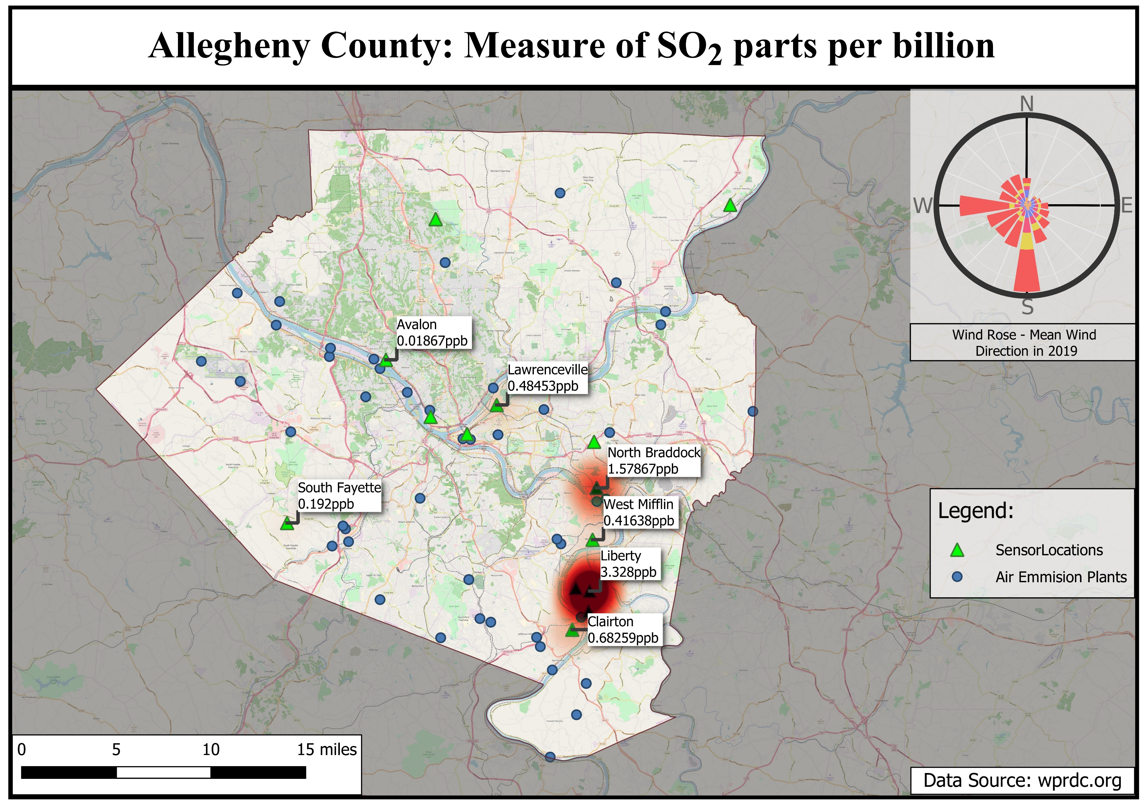
Notes:
Original data was recorded hourly, then averaged to result in a daily value.
SO₂ map shows the average daily value per year in parts per billion.
Workflow:
1. Imported all PA counties on top of the open street maps
2. Removed all county entries from the attributes table except for Allegheny
3. Imported the layer of all Air emission plants for all of PA
* Using the Allegheny county layer, I could "clip" everything that was outside of the county
5. Added the layer of sensor locations in Allegheny county
6. Created a "screen" layer that contained the surrounding area (enough to make a map) that would be colored grey with light opacity (help focus attention to Allegheny county)
* Again using the Allegheny county layer to do this
7. Added the .csv SO2 data
8. Formatted the data to be in ppb
9. Formatted the data points to be a heat points (bigger and darker for larger numbers)
10. Formatted the data callouts to read the location and the measure in ppb

Slide 4
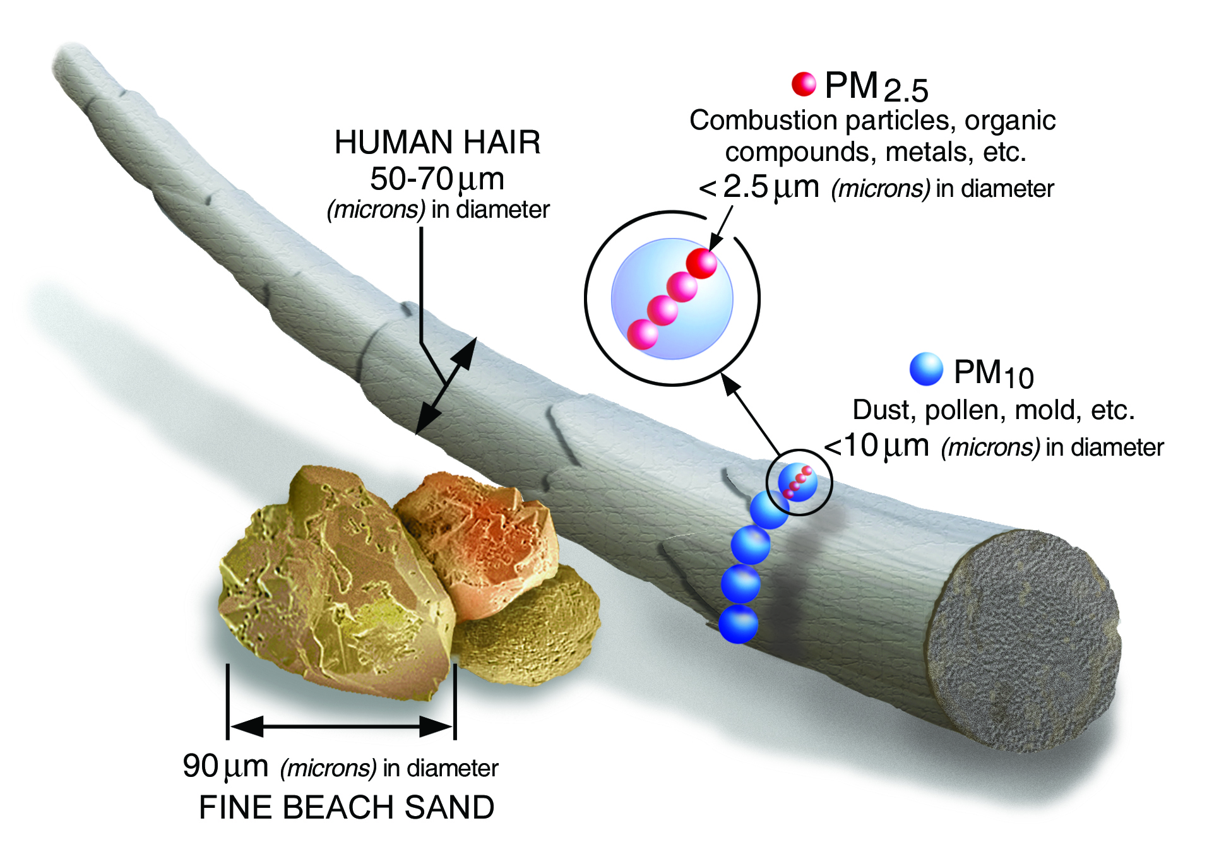
2.5 μm Particulates (PM_{2.5}) – Size

Slide 5
2.5 μm Particulates (PM_{2.5})
Sources of PM_{2.5}
Direct – combustion sites (coal/gas-fired power plants, fireplaces, automobiles)
Reactions involving Sulfur Dioxides and Nitrogen Dioxides
Harmful Effects of PM_{2.5}
Main culprit causing haze
Long-term exposure increases mortality rate (especially cardiovascular)
High concentrations can exacerbate lung & heart problems
Entry deep into lungs and thereby bloodstream

Slide 6
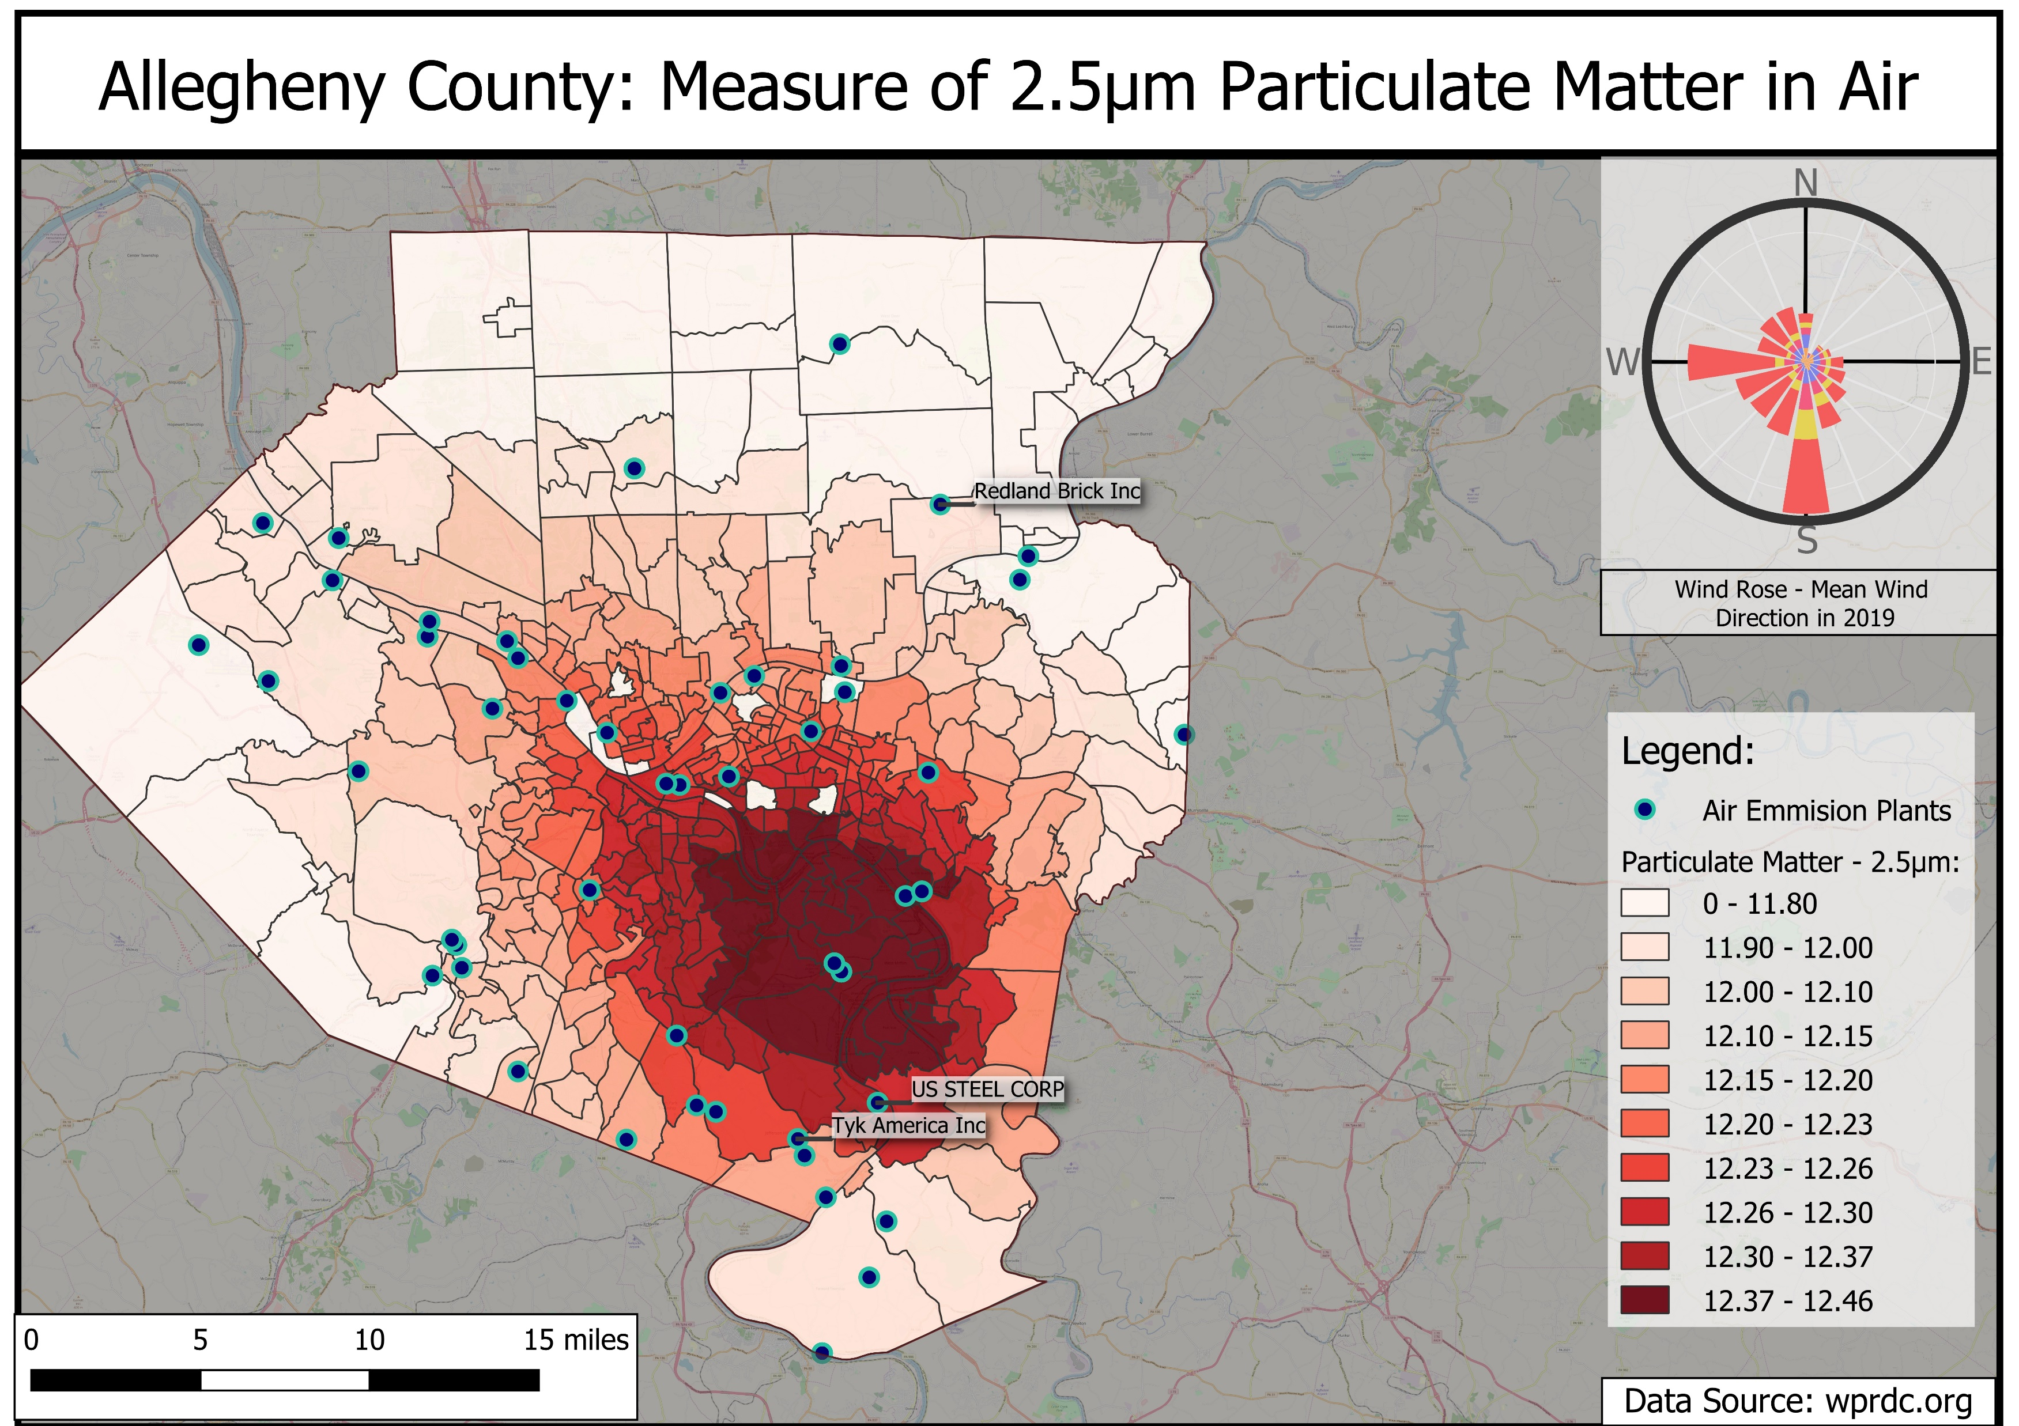
Notes:
Workflow:
Imported all PA counties on top of the open street maps
Removed all county entries from the attributes table except for Allegheny
Imported the layer of all Air emission plants for all of PA
*Using the Allegheny county layer, I could "clip" everything that was outside of the county
Created a "screen" layer that contained the surrounding area (enough to make a map) that would be colored grey with light opacity (help focus attention to Allegheny county)
*Again using the Allegheny county layer to do this
Added the 2.5mm particulate data
*Formatted the data to display 10 color buckets
*Formatted the data callouts to only show names for locations that are not in compliance

Slide 7
Conclusions
South East of downtown Pittsburgh has the highest concentration of pollution
This area contains high-concentration pockets of SO2 and more 2.5 μm Particulates than other neighborhoods
Sulfur Dioxide (SO2)
Liberty is 2 times more polluted than the 2nd most polluted area in the county
Liberty is >17,800% worse than the best area, Avalon
2.5 um Particulates (PM2.5)
Lincoln Place is 111% more polluted than the cleanest area, Harrison Twp
Notes:
Based on the data about SO2 and 2.5mm particulates, the area SouthEast of downtown Pittsburgh has a higher concentration of pollution than the rest of the city & county.
This area (Homestead, North Braddock, West Mifflin, Liberty, Clarion, McKeesport, Brentwood, Pleasant Hills), has high pockets of SO2 and overall has more 2.5mm particulates than the rest of the county.
## Specific Pollution Conclusions:
* SO2: The worst location (Liberty, 3.328ppb) is 2 times worse than the next most polluted area (North Braddock, 1.578ppb) and compared to the least polluted location (Avalon, 0.0187ppb) Liberty is 17,800% more polluted.
* 2.5μm Particulates: The worst location (Census Tract 310200, Lincoln Place, 12.456 microgram/m3) is 111% more polluted than the cleanest area (Census Tract 401100, Harrison Twp, 11.251 microgram/m3).
Harrison Twp is very far north east up rt 28. The edge of Allegheny county

Slide 8
Sources
Allegheny County Air quality
https://data.wprdc.org/dataset/allegheny-county-air-quality
https://catalog.data.gov/dataset/allegheny-county-air-quality
Pollution Map
https://breatheproject.org/pollution-map/
EPA Search
https://edg.epa.gov/metadata/catalog/main/home.page
Allegheny County Particulate Matter - 2.5mm
https://data.wprdc.org/dataset/particulate-matter-2-5

Slide 9
Sources
Wind rose sites
https://www.meteoblue.com/en/weather/archive/windrose/pittsburgh_united-states-of-america_5206379
https://wrcc.dri.edu/cgi-bin/wea_windrose.pl?laKAGC
https://mrcc.illinois.edu/CLIMATE/Hourly/WindRose.jsp
https://www.climate.gov/maps-data/dataset/wind-roses-charts-and-tabular-data
Pittsburgh Data
http://www.pasda.psu.edu/
http://www.wprdc.org/

